Slide 1
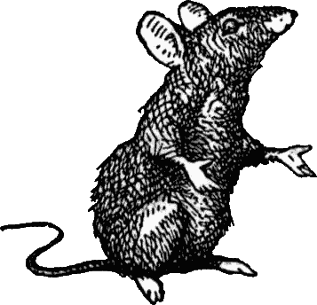
The Causes and Spread of the Black Death

Slide 2
What do you know about what causes disease?
You’re an educated modern person who has grown up with knowledge of science.
What causes disease?

Slide 3
What do you know about what causes disease?
You’re an educated modern person who has grown up with knowledge of science.
What causes disease?
Germs, viruses, bacteria
Poor hygiene, unhealthy living conditions
Contact with sick people
What’s your best guess about what caused the Black Death to spread?

Slide 4
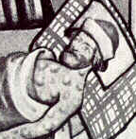
What do you know about what causes disease?
Now imagine you’re a peasant in medieval Europe during the 14th century.
Germs, viruses and bacteria haven’t been discovered yet.
Chances are you can’t read or write.
All that you know about how the world works was taught to you at church.
People around you are getting sick.
What would you believe is causing everyone around you to get sick?

Slide 5
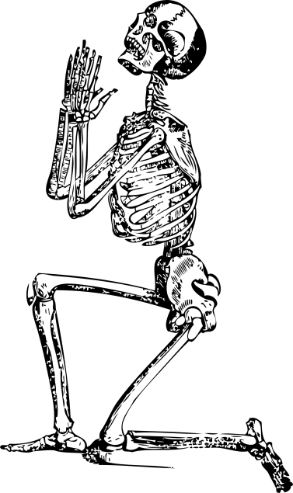
Medieval Medicine

Slide 6
Beliefs about the cause of the Black Death
Which of the following were beliefs held by contemporary people in the Middle Ages, regarding what caused the Black Death.
“The aerial spirit escaping from the eyes of the sick man strikes the healthy person standing near and looking at the sick”
Jews poisoned all of the drinking water.
Dirty homes, sewerage filled streets and soiled food brought disease.
Earthquakes releasing poisonous fumes.
The conjunction of three planets in 1345 caused a "great pestilence in the air".
When the sea rose high, the Devil sent forth poison in the air.
God was punishing mankind for their sins.
Close contact to others with the pestilence.
Notes:
Sources: History Channel, Wikipedia and BBC - History

Slide 7
Beliefs about the cause of the Black Death
The following are REAL beliefs held by contemporary people in the Middle Ages, regarding what caused the Black Death:
“The aerial spirit escaping from the eyes of the sick man strikes the healthy person standing near and looking at the sick”
Jews poisoned all of the drinking water.
Dirty homes, sewerage filled streets and soiled food brought disease.
Earthquakes releasing poisonous fumes.
The conjunction of three planets in 1345 caused a "great pestilence in the air".
When the sea rose high, the Devil sent forth poison in the air.
God was punishing mankind for their sins.
Close contact to others with the pestilence.
Notes:
Sources: History Channel, Wikipedia and BBC - History

Slide 8
Beliefs about the cause of the Black Death
The Medical Faculty at a university in Paris told the King of France that the close alignment of three planets caused ‘bad air’ which caused the plague.
The conjunction of three planets in 1345 caused a "great pestilence in the air".
Notes:
Sources: History Channel, Wikipedia and BBC - History

Slide 9
‘Disease’ was simply not understood.
However, not many realised the dangers of poor hygiene or close contact with the ill … though some may have suspected.
Dirty homes, sewerage filled streets and soiled food brought disease. The conjunction of three planets in 1345 caused a "great pestilence in the air".
Close contact to others with the pestilence.
Notes:
Sources: History Channel, Wikipedia and BBC - History

Slide 10
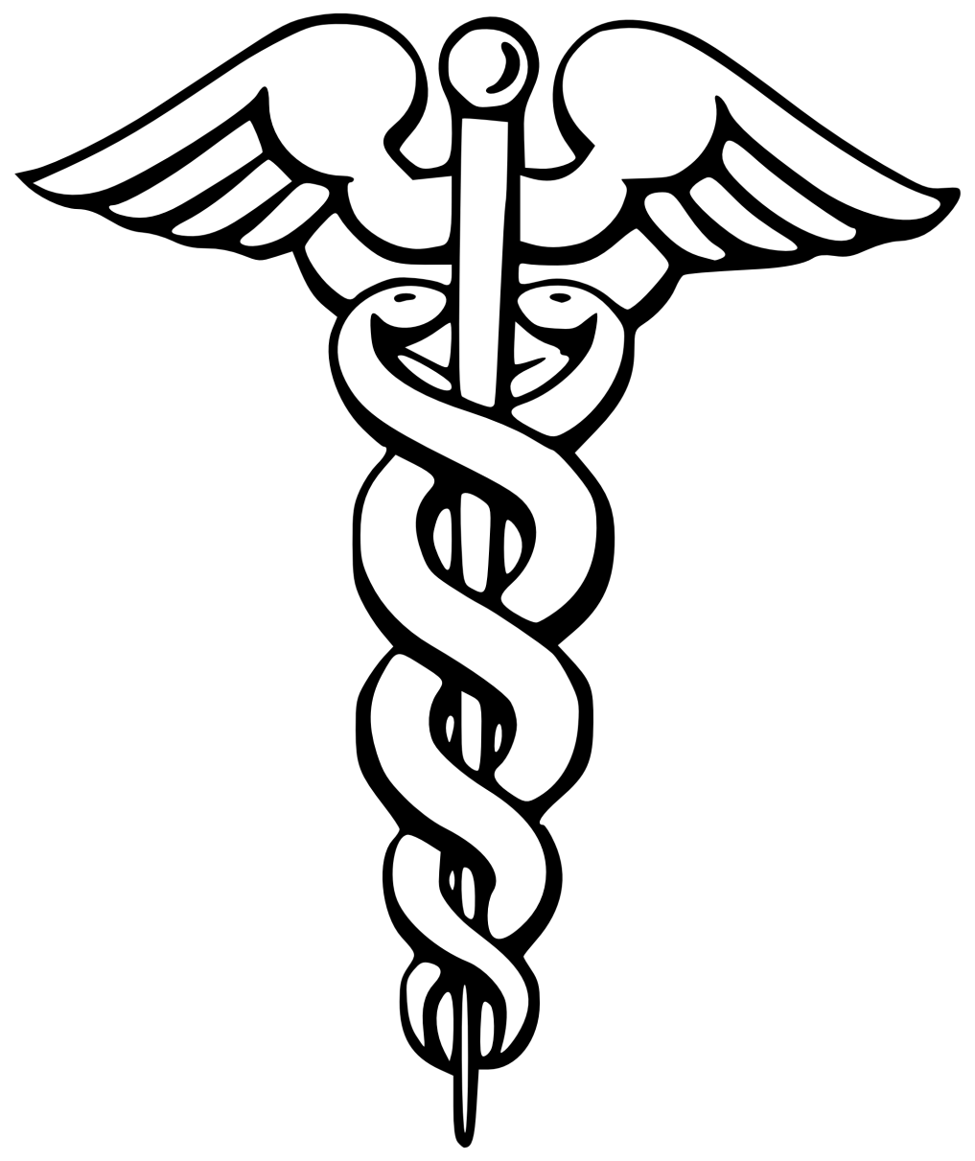
Medicine in the Middle Ages
Medicine was not a science but more like a ‘craft’.
Doctors were not scientists, which means they did not base their ideas on observation and evidence.
They had strange ideas about the body which were based on belief and religious faith.

Slide 11
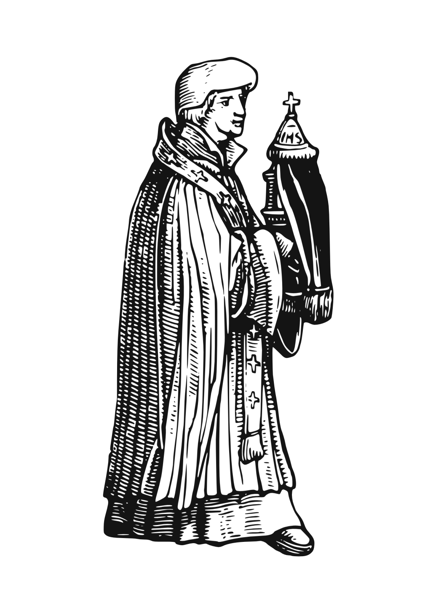
Medicine and Religion
The natural and supernatural were interconnected.
It was ‘Gods will’ that you would fall ill …or get better.

Slide 12
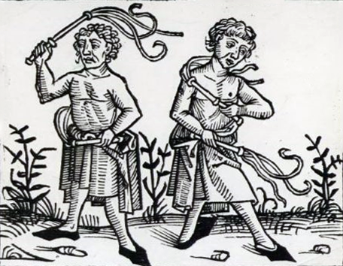
God’s Punishment
Most believe Black Death is sent by God to punish people for their sins.
Many pray for forgiveness.
The Flagellants were a group which travelled, whipping themselves and singing hymns, to win God's forgiveness.
Monty Python’s parody of Flagellants:
https://www.youtube.com/watch?v=e4q6eaLn2mY

Slide 13
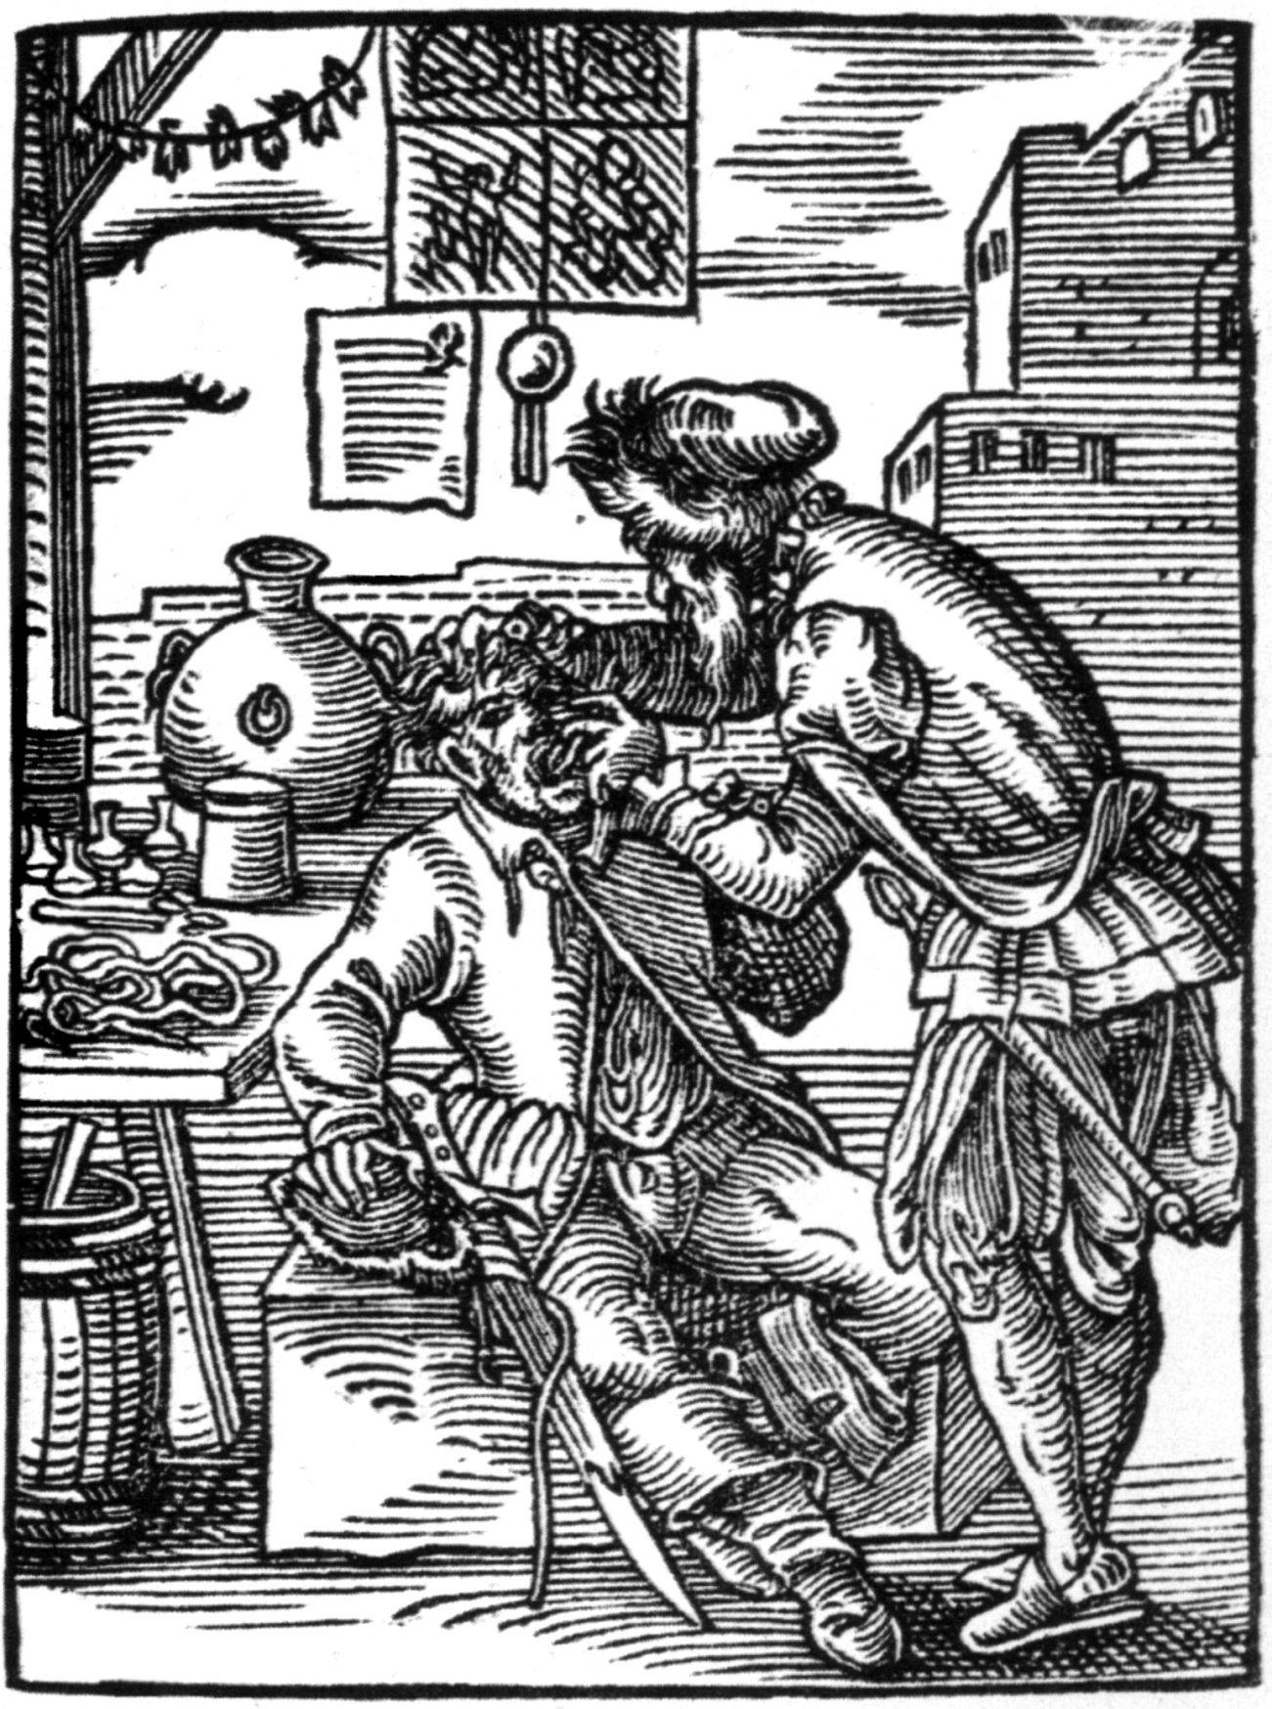
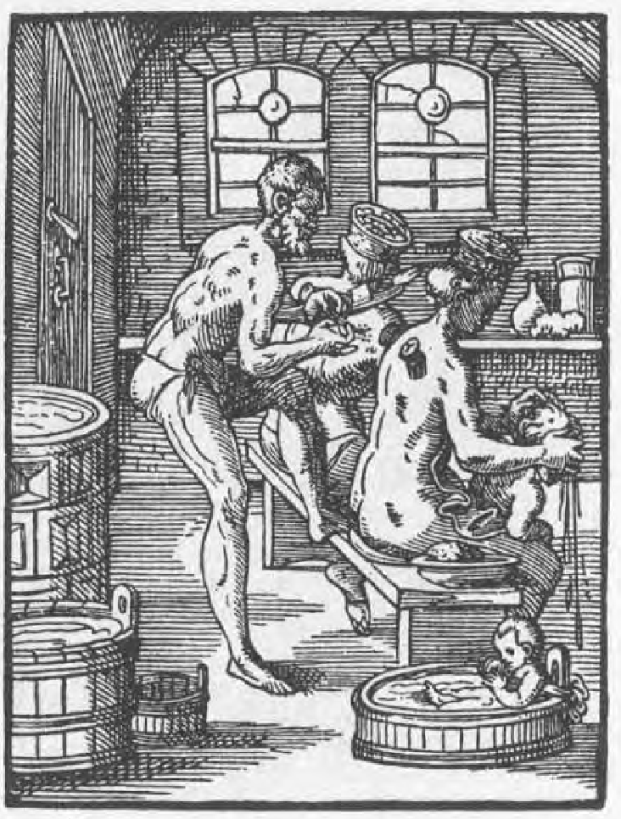

Barber Surgeon
Doctors rarely performed surgery in the Middle Ages: instead barbers (hairdressers!) performed surgery and dentistry – usually without anaesthetic!
Random fact: The red/white pole often seen outside barber shops is said to represent the blood and bandages of the barber surgeon.
The Worst Jobs in History:
Barber Surgeon
https://www.youtube.com/watch?v=JVQO0a4mMWs

Slide 14
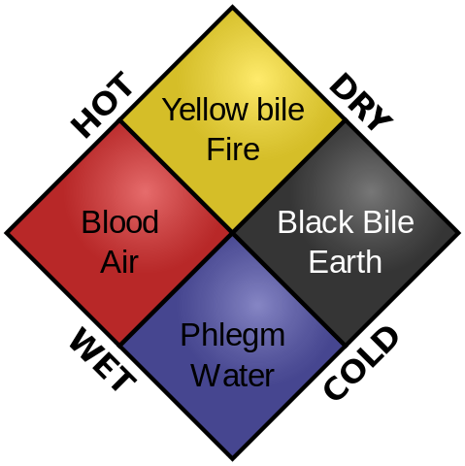
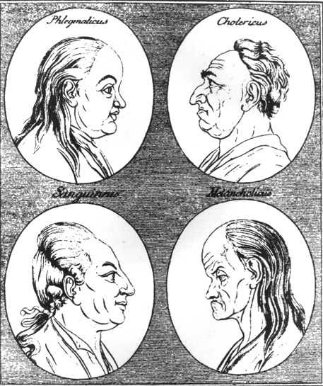
The Four Humors
A common belief was that the body was composed of ‘four humors’ (blood, phlegm, yellow bile and black bile). An imbalance – too much or too little in of one humor – would cause sickness.
Certain personality types were associated with overabundance of one humor: phlegmatic; choleric; sanguine; melancholic (Believe it or not, we still use these terms today!).
This belief originated in the philosophy of the Ancient Greeks.

Slide 15
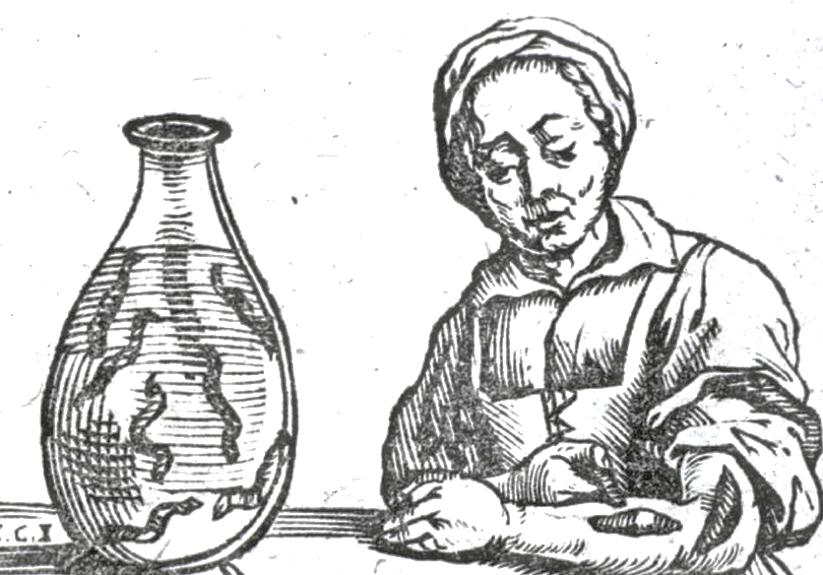
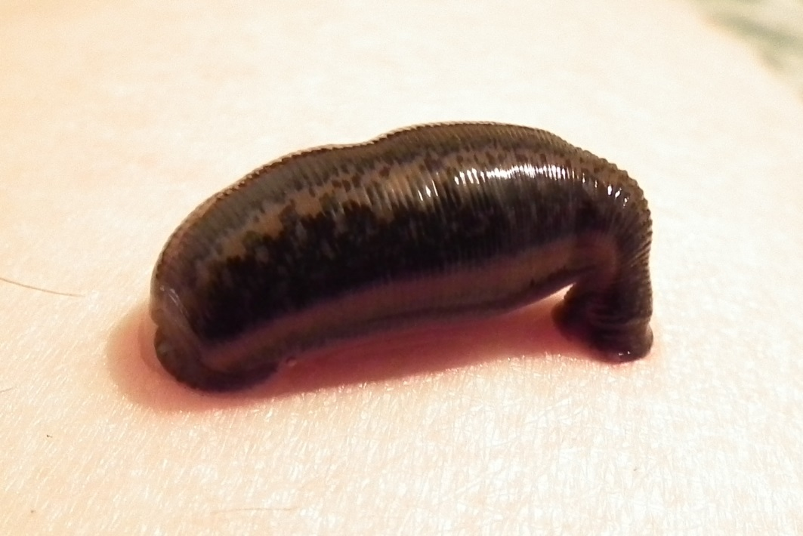
Treatment in the Middle Ages
How to rebalance the humors?
Treatments included ‘leeches’ ..

Slide 16
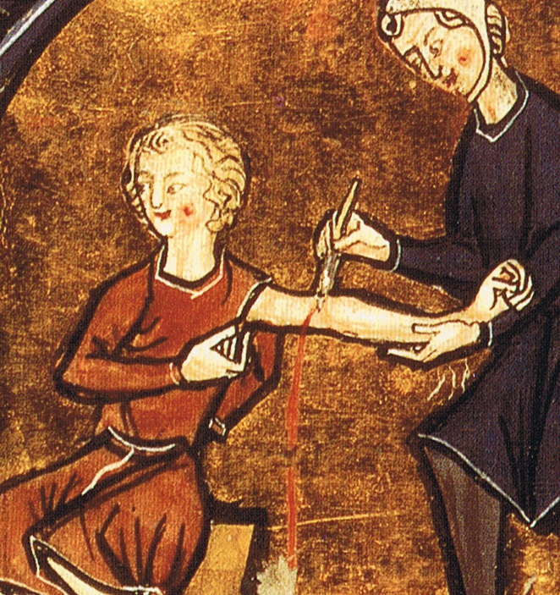
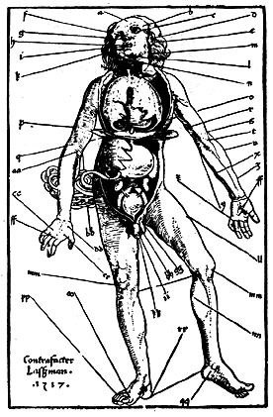
Treatment in the Middle Ages
… and bloodletting (phlebotomy), to allow the bad ‘humors’ to escape.
This is a chart identifying where to release blood to rebalance the humors.

Slide 17
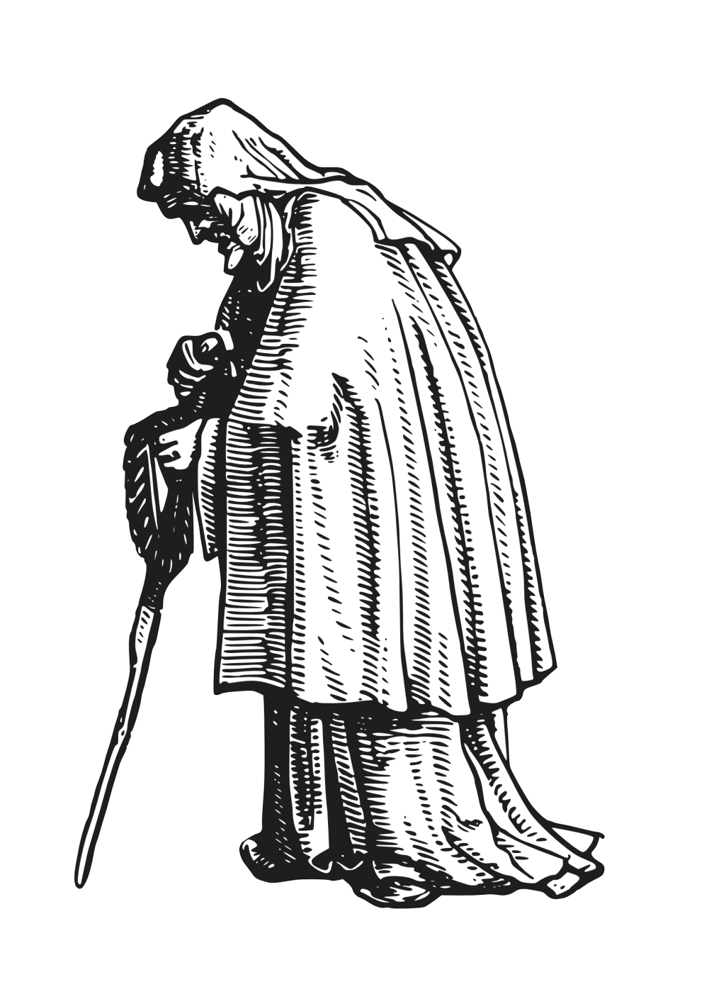
Treatment in the Middle Ages
Doctors were only for the wealthy.
Many would be treated by monks, who studied the same medical texts the doctors studied in their universities, and grew medicinal gardens.
Most peasants, however, sought out folk-healers whose herbal remedies were passed down through the generations.

Slide 18
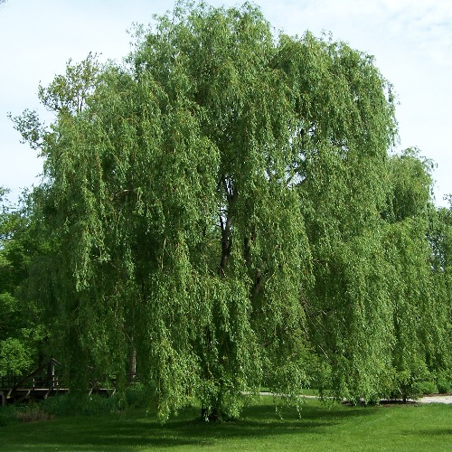
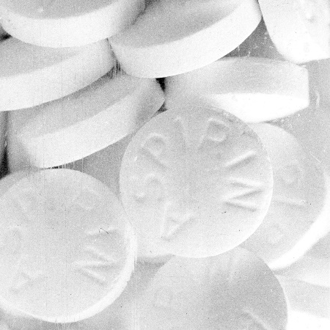
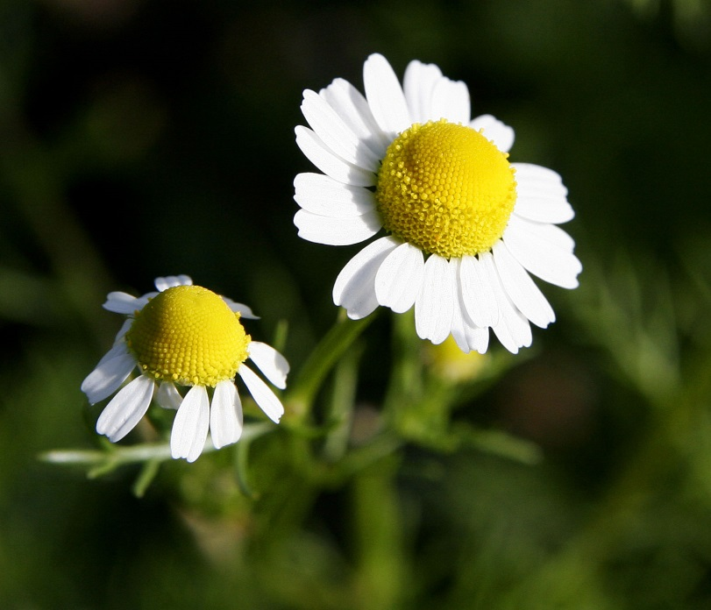
Herbal Remedies
Actually, some of these herbal remedies were effective and are still used today:
Willow tree bark tea for headaches and reducing fevers. The bark contains a chemical called salicylic acid which you might know as Aspirin.
Chamomile flower tea for headaches and digestion.
Sage leaf as a general cure-all.
Valerian root for insomnia.

Slide 19
So what really caused the Black Death?

Slide 20

What causes disease to spread?
What causes disease?
What things can cause disease to spread quickly?

Slide 21
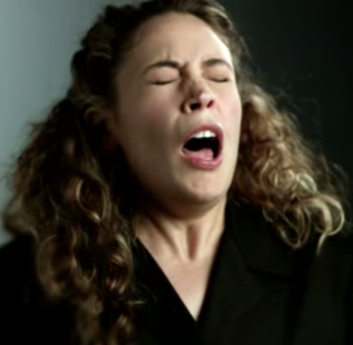
What causes disease to spread?
‘Sneeze’ Ad:
https://www.youtube.com/watch?v=qKiQA5e-fPg
Source: SA Health http://www.sahealth.sa.gov.au/
Spread of Disease through Contact Video:
https://www.youtube.com/watch?v=BMuubL0wBCo
Science Cast: How disease spreads.
https://www.youtube.com/watch?v=5rWKlN_nz5Y

Slide 22
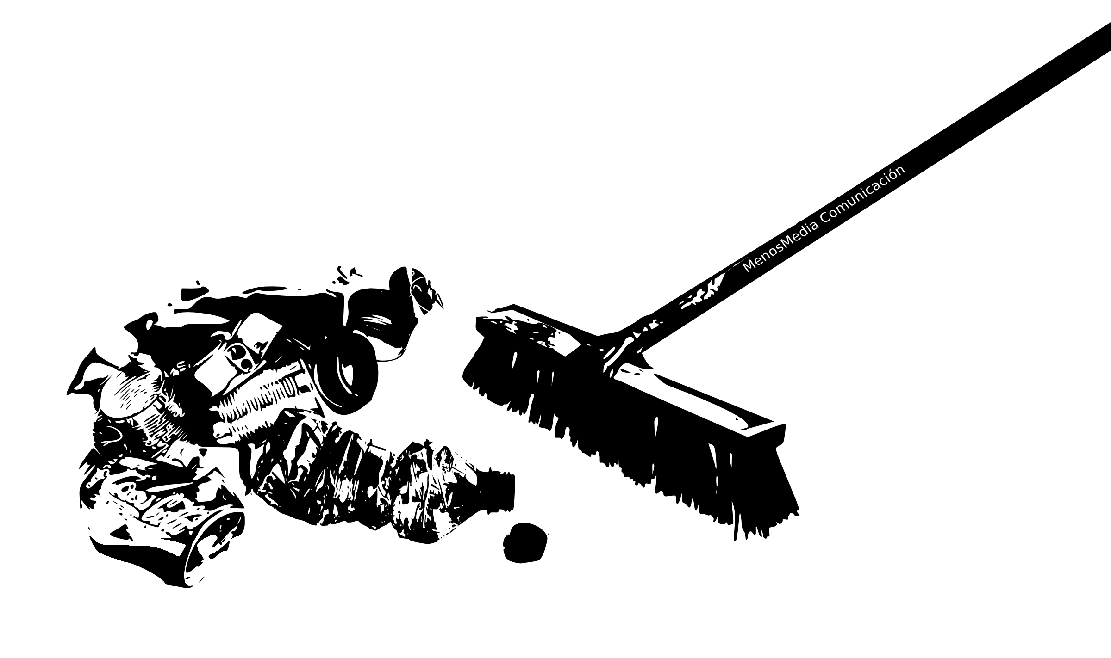
What do we do to keep our homes hygienic?
What about our school or workplaces?
Our streets?
Our public places?

Slide 23
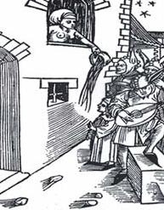
Living Conditions in Medieval Europe
Imagine:
No running water
Sewerage, garbage, dead animals in the street
‘Rushes’ (straw) was used to cover floors
People often wouldn’t wash and wear the same set of clothes constantly for months

Slide 24
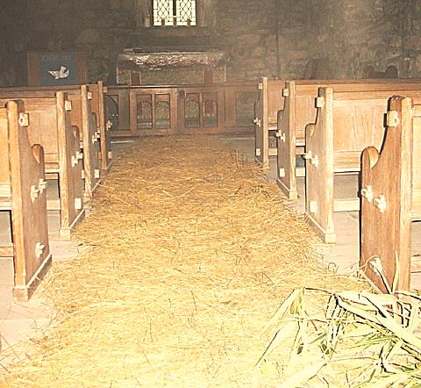
Living Conditions in Medieval Europe
Read this description of the floors of medieval homes.
How would this have contributed to the spread of disease?
On using rushes (straw) as a floor covering:
"... floors are laid with white clay, and are covered with rushes, occasionally renewed, but so imperfectly that the bottom layer is left undisturbed, sometimes for twenty years, harbouring expectoration, vomiting, the leakage of dogs and men, ale droppings, scraps of fish, and other abominations not fit to be mentioned...“
Source: Erasmus
‘Rushes’ were a common floor covering.

Slide 25
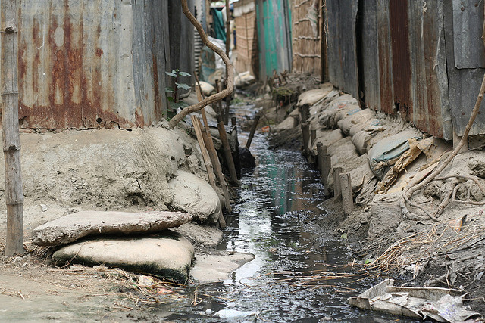
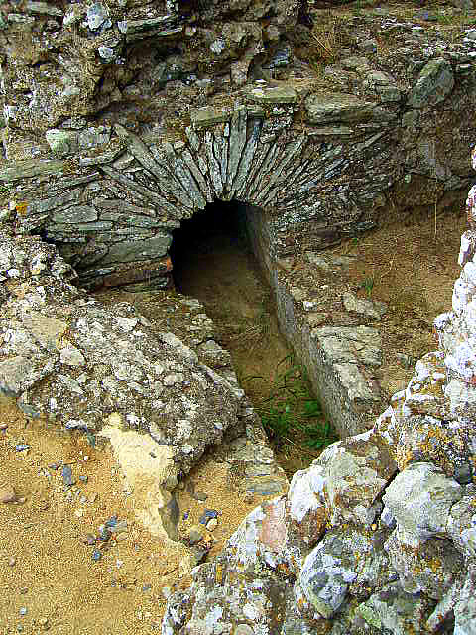
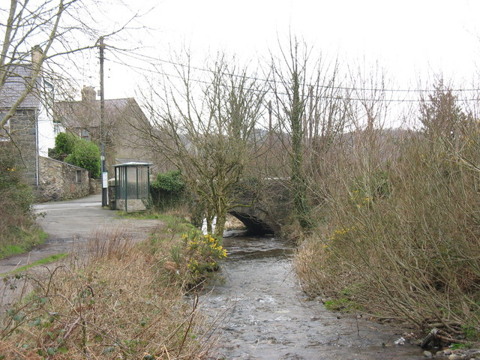
Open Sewers
What happens to your sewerage?
The Romans had engineered sewer systems
… however, much of this medieval Europe did not: waste was poured straight into the street.
When underground sewers were introduced, hygiene greatly improved … something that happened more recently than you might realise!
This river in Wales was an open sewer until the 1960s, when a sewerage plant was built upstream!

Slide 26
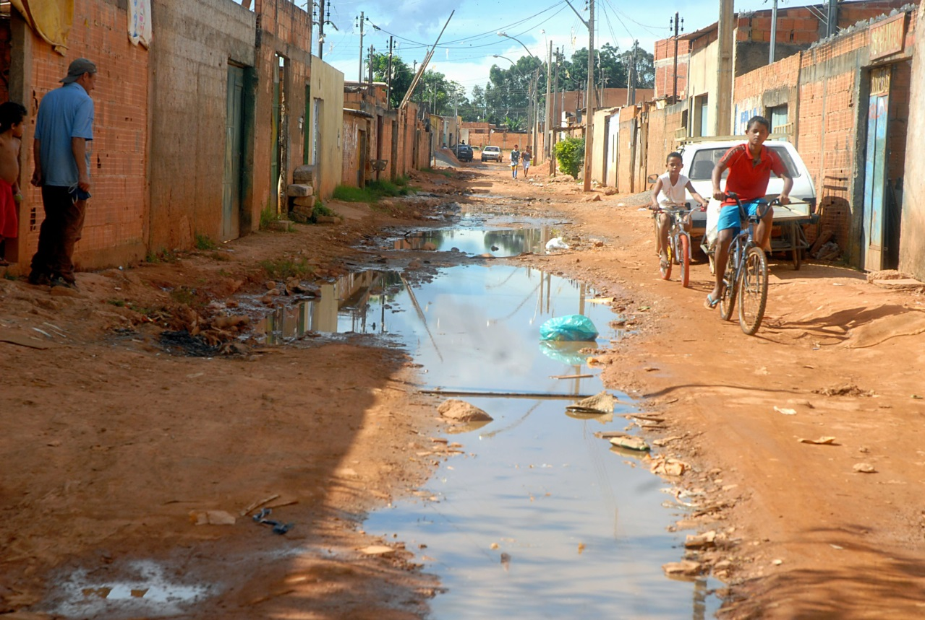
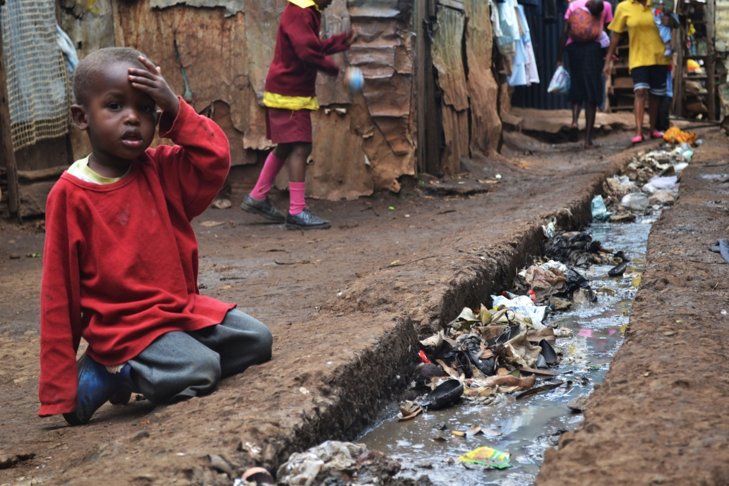
Open Sewers
Sanitation continues to be a major problem in many parts of the world: such as in these photos of slums in Brazil and Kenya.
What impact on health could these sewers have?

Slide 27
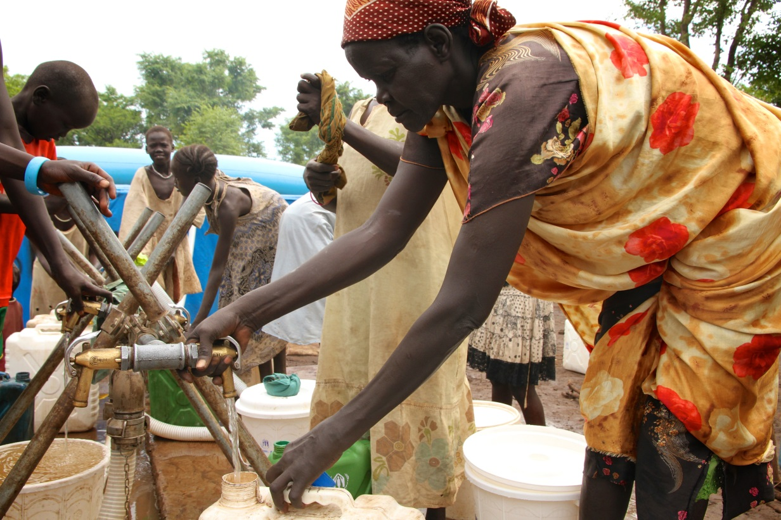
Water
Where does your water come from?
Often medieval Europeans drew water from wells and rivers … which were often contaminated by the sewers.
Clean water is probably the most important health issue all over the world. More than 3.4 million people die each year due to unclean water. Source: Water.org
Oxfam is an organisation that works to provide clean water.

Slide 28
Life Expectancy in the Middle Ages
So, as you could imagine, it was very difficult to survive in medieval Europe. Life expectancy was only to the mid-late 40’s:
As much as 1/3 of all children died before the age of 5; up to 20% of women died in childbirth.
Anaemia, rheumatism, arthritis, tuberculosis, small pox, syphilis, and dysentery common
Influenza (the ‘sweating sickness’)
Antiseptic agents like alcohol was available but they were not aware that it could prevent disease.
Most open wounds would fester and gangrene.

Slide 29
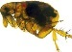
Enter the Black Death!

Slide 30
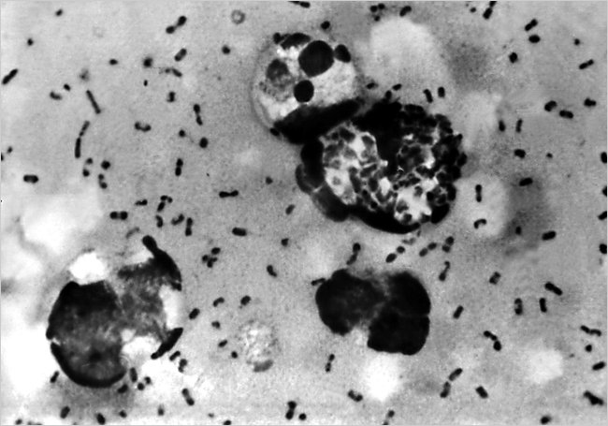
Enter the Black Death
Into this grotty bleak world comes the Black Death in the mid 14th century.
Recently, DNA testing of bodies buried in plague pits have identified what is probably the cause of the Black Death epidemic: a bacteria called yersinia pestis.
Yersinia Pestis.
Source: CDC.

Slide 31
Can you guess …
… how the Black Death was spread?
IT WAS THE RATS!

Slide 32
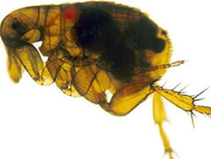
Can you guess …
… how the Black Death was spread?
IT WAS THE RATS!
Or rather, their fleas.

Slide 33
The Oriental Rat Flea
The yersinia pestis bacteria is transmitted to humans through flea bites.
The fleas live only on small rodents, such as rats, marmots and ferrets.
Of course, you could contract it through contact with other sufferers.
An oriental rat flea engorged with blood after feeding.

Slide 34
Rats … and fleas …
… love dirty conditions.
Think about those floors covered with layers of mouldering straw …
Clothes worn for days on end with no bathing.
Open sewers.
It didn’t take long for the rats and their fleas to spread.

Slide 35
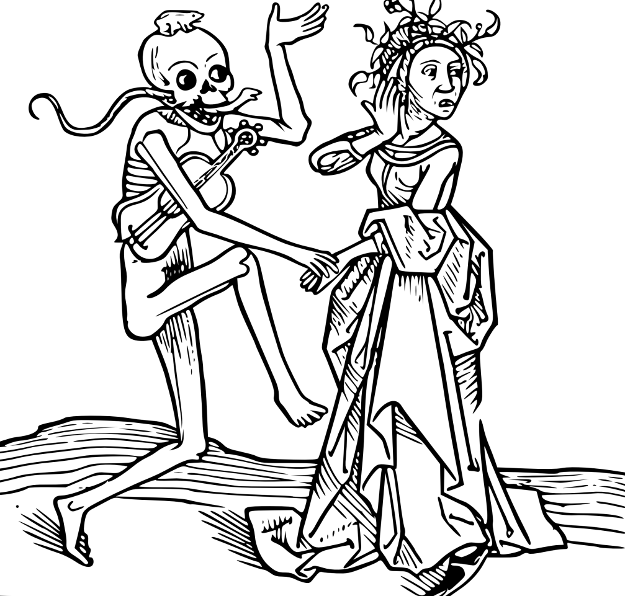
But where did it come from?

Slide 36
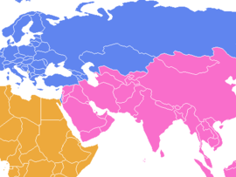
Where did it begin?
DNA evidence has traced yersinia pestis back to its origin:
Central Asia,
(modern day China)
It had been around for 2000 years before it started making its journey across Eurasia.
Europe
Here
Modern China
North Africa
Arabia
India

Slide 37
Where did it begin?
But how does a disease travel so far?
Why did it stay in the one place for 2000 years, but then suddenly go west?
Any ideas?
Europe
Here
Modern China
North Africa
Arabia
India

Slide 38
Where did it begin?
But how does a disease travel so far?
Why did it stay in the one place for 2000 years, but then suddenly go west?
Any ideas?
Europe
Here
Modern China
North Africa
Arabia
India

Slide 39
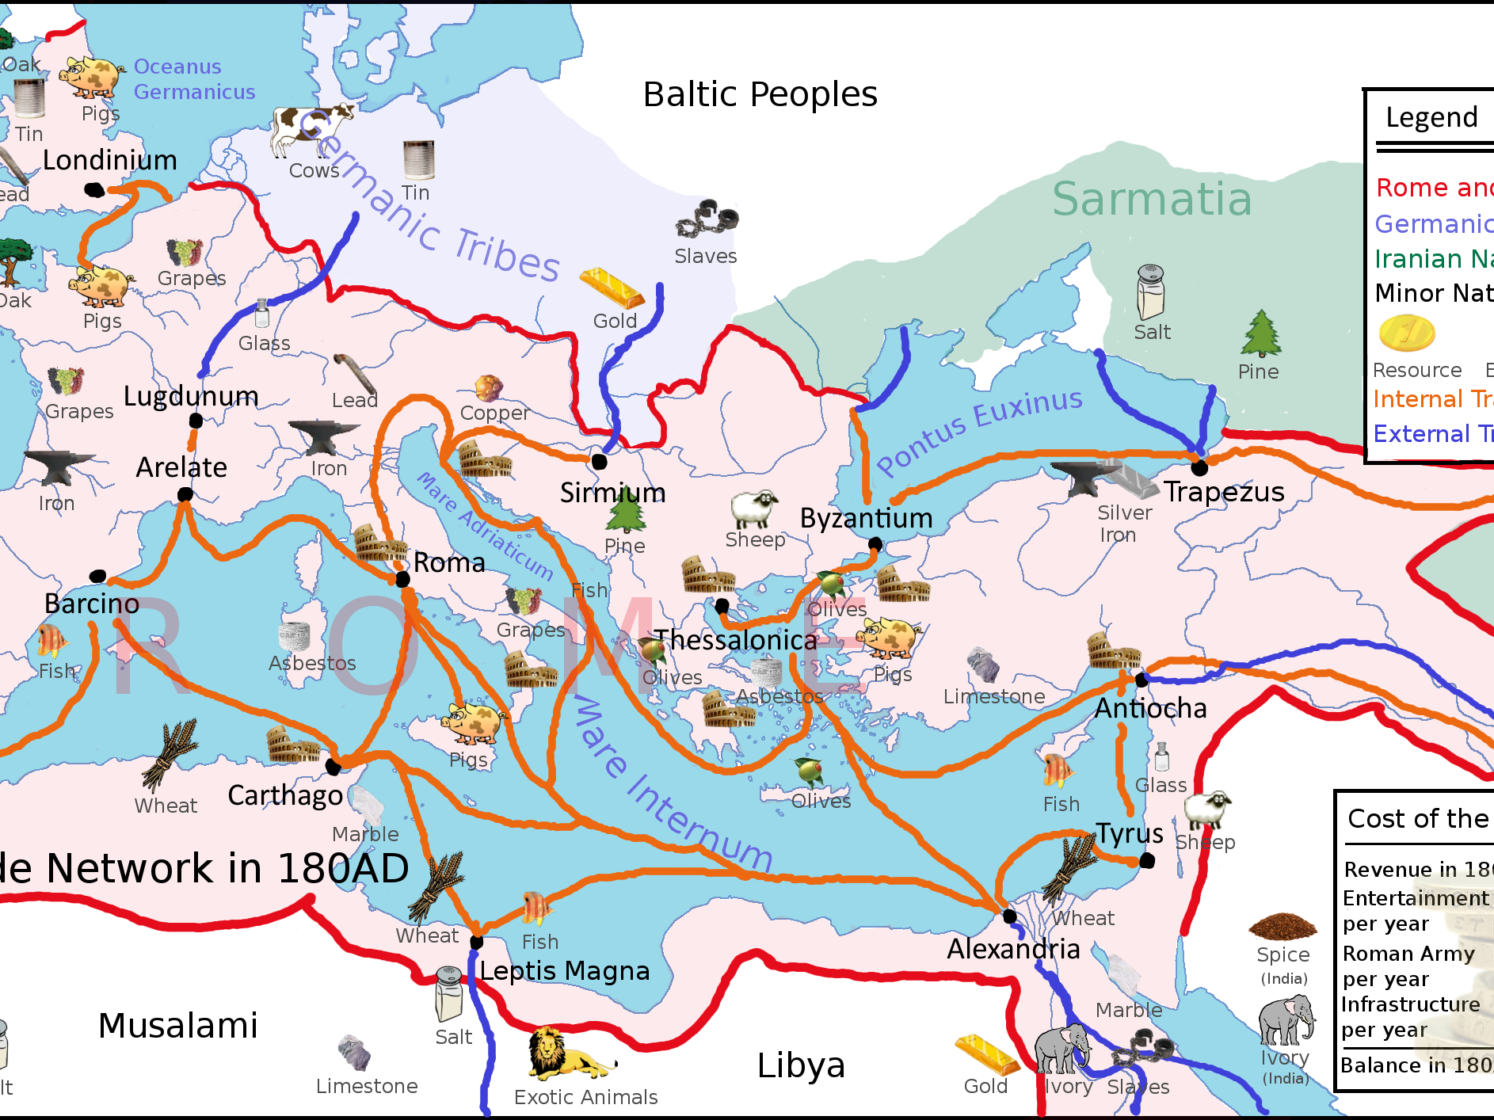
Trade!
The Romans had great trade networks: products were traded between Western Europe, North Africa, the Middle East and the far Orient. These networks collapsed after the fall of the Roman Empire.

Slide 40
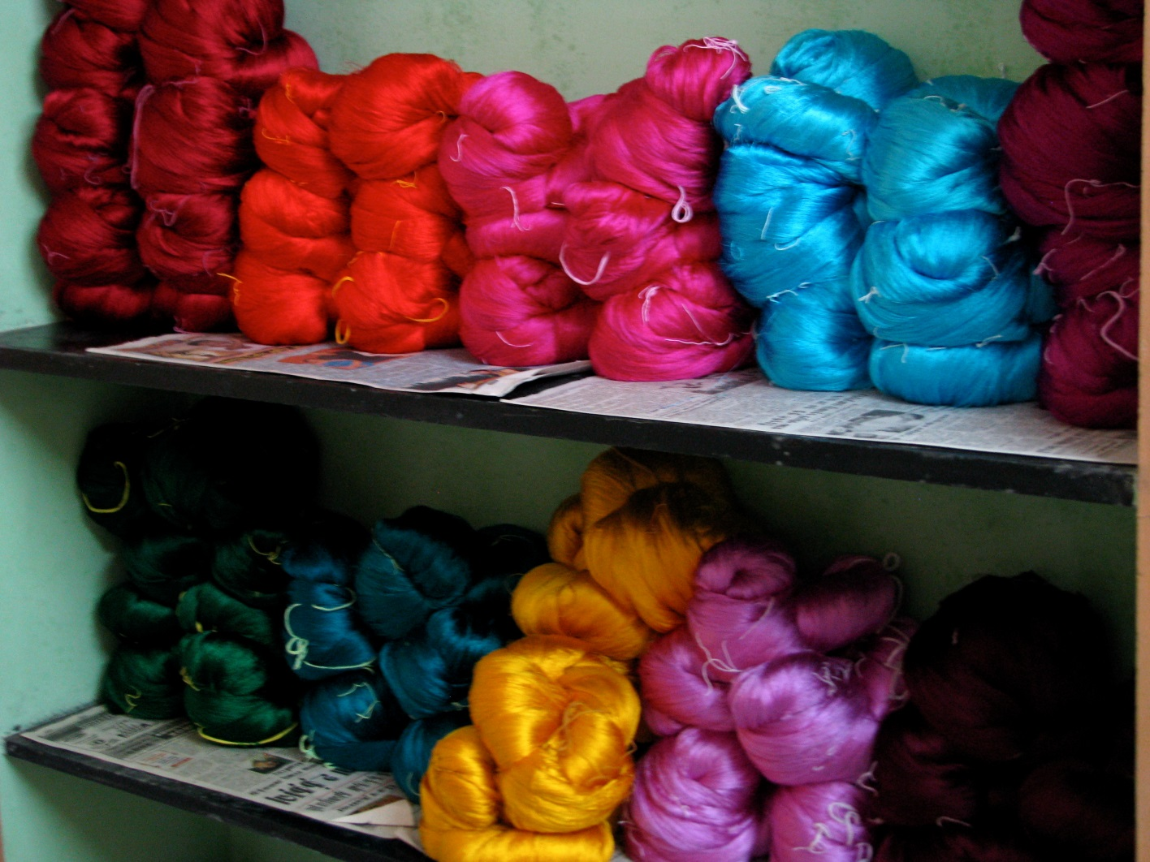
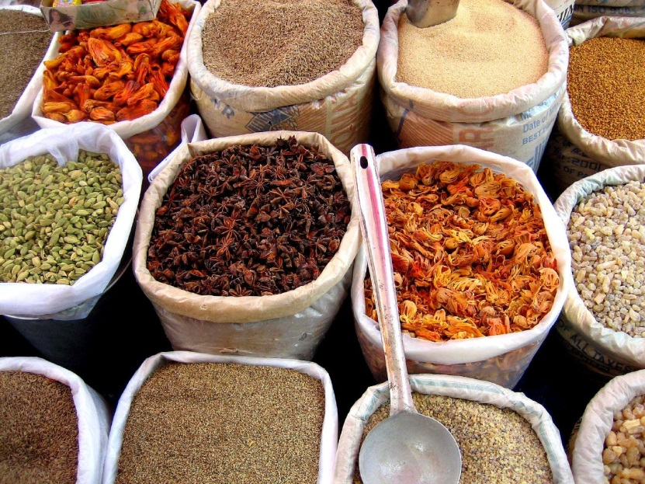
Trade in the Middle Ages
By the 1300s cargo ships from Venice or Genova (Italian city-states) were arriving in European cities with exotic products like silk, spices and precious metals. These cities sourced their products from Asia via the ‘Silk Road’.

Slide 41
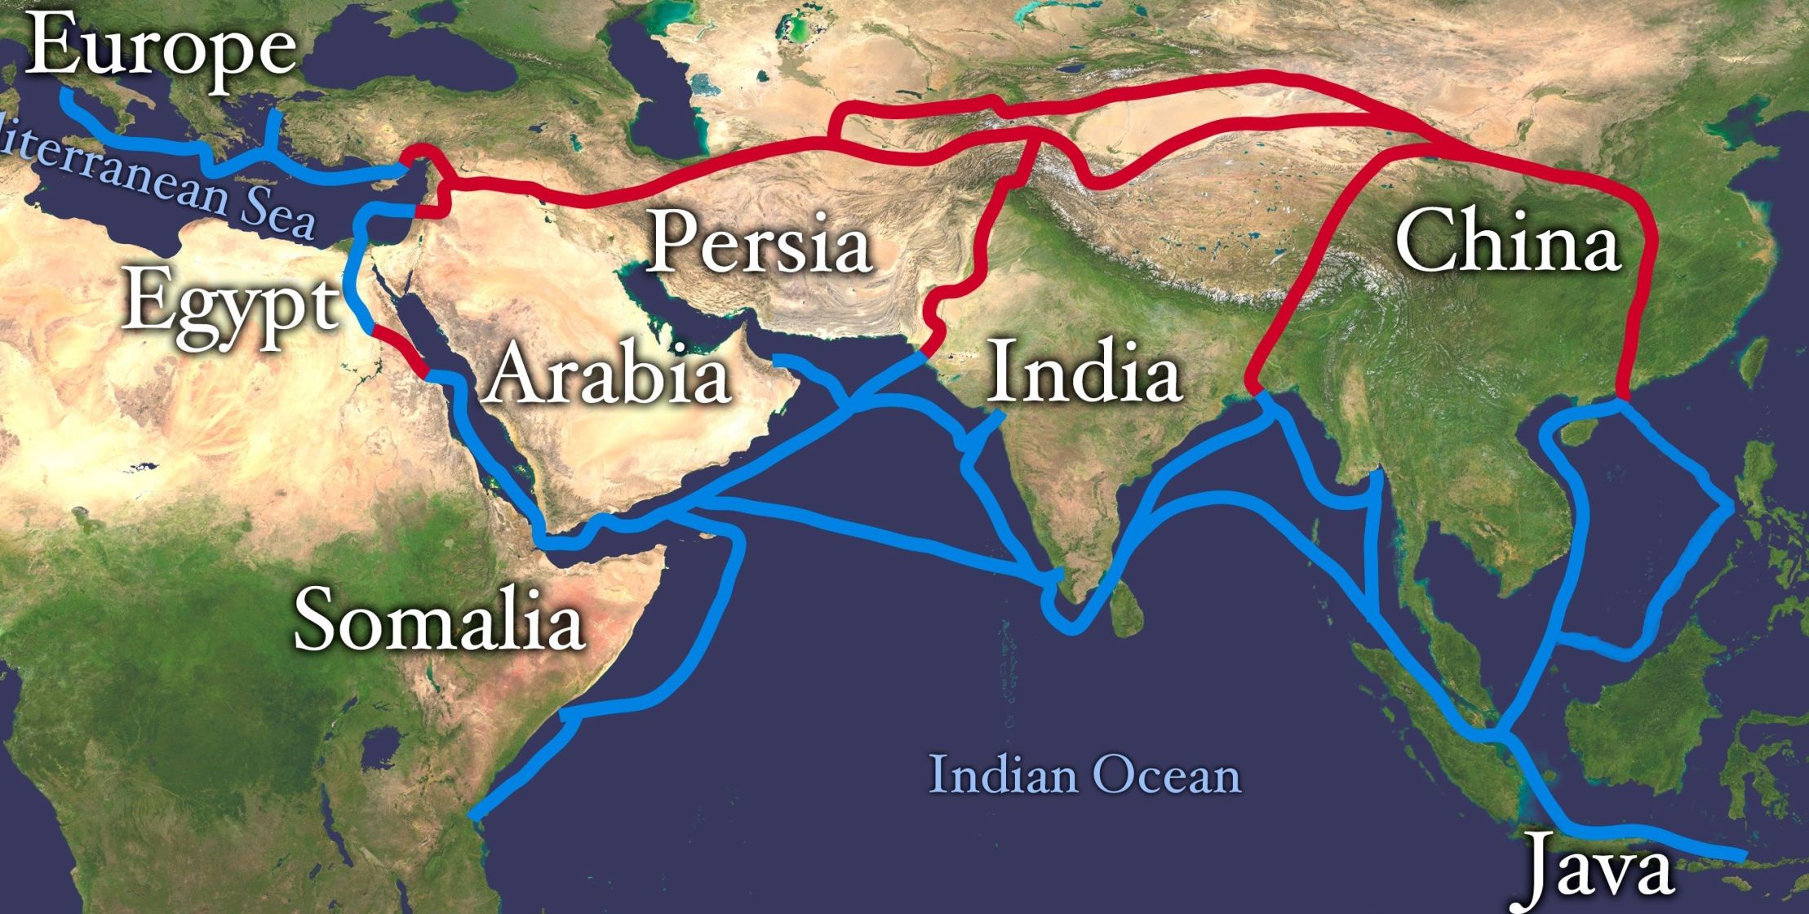
The ‘Silk Road’
Once established, ‘caravans’ of traders would regularly travel across the continent or around the oceans on the ‘Silk Road’.

Slide 42
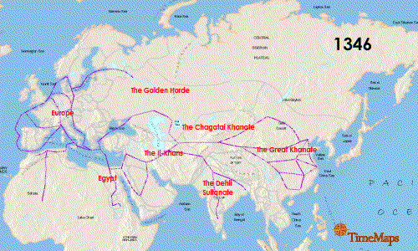
Spread of the Black Death
On this map, the major trade routes are shown in Purple.
What do you notice about the spread of the Black Death?
Source: Wikimedia Commons, by Timemaps - http://upload.wikimedia.org/wikipedia/commons/f/f8/Spread-Of-The-Black-Death.gif

Slide 43
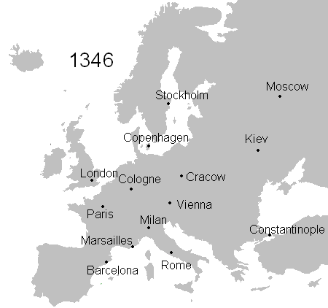
Trade in the Middle Ages
Rats infested with fleas carrying yersinia pestis, travelled on merchant trading ships. After jumping ship in trade cities like Constantinople, Genova and Venice, it made its way overland.

Slide 44
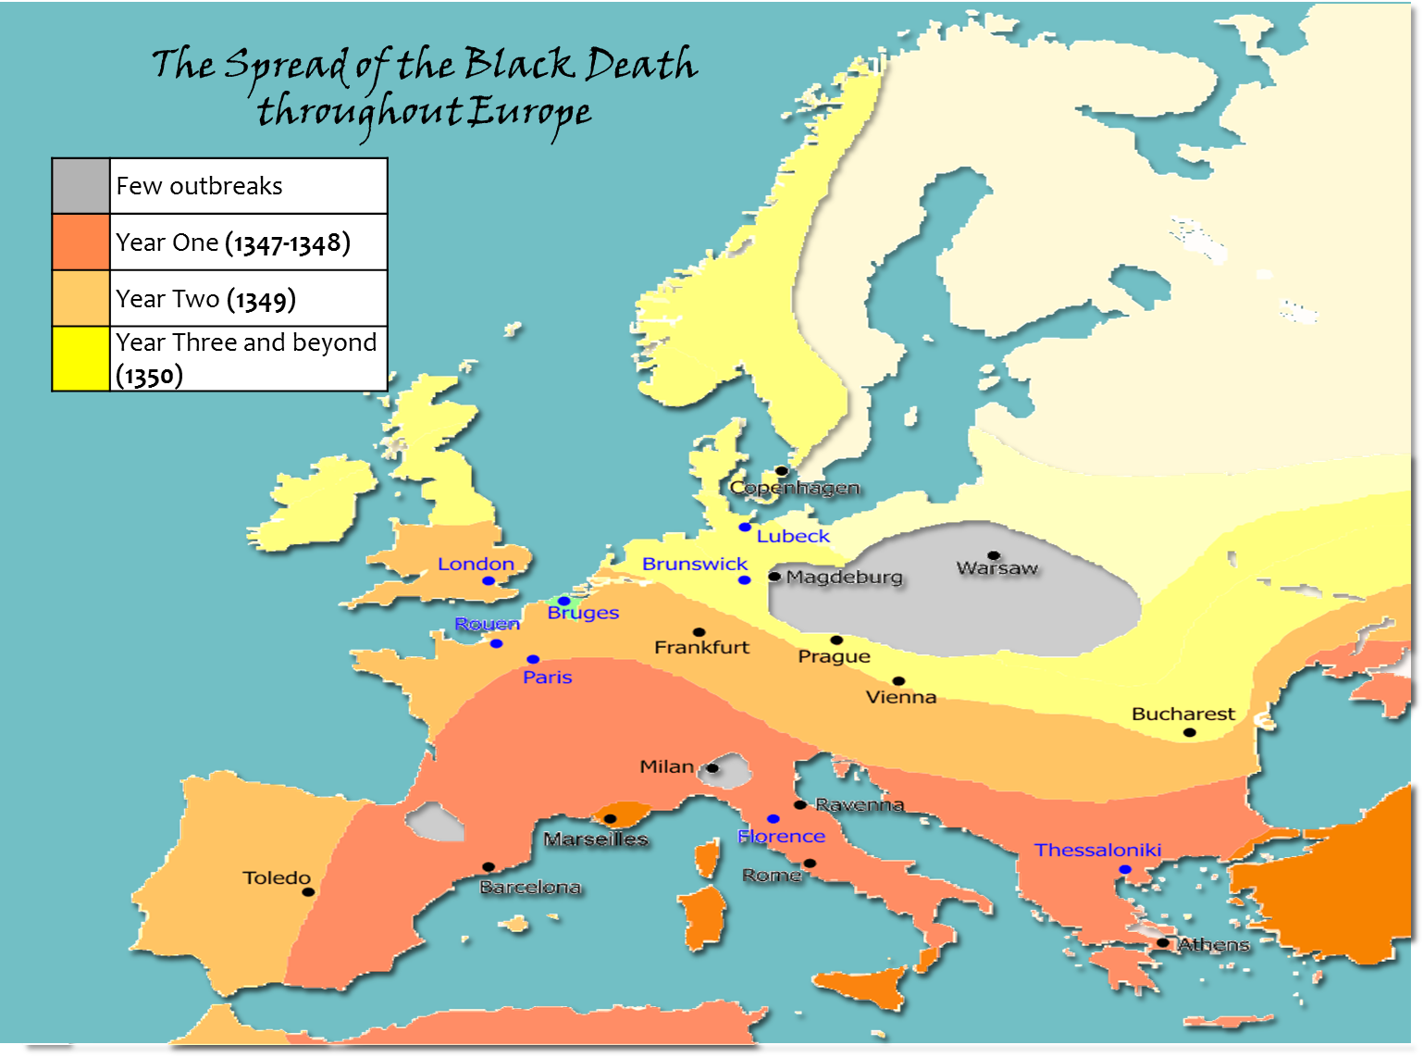
Notes:
Students colour their map to match this coloured version.

Slide 45
Epidemics
Can you imagine if the Black Death happened today?
What would be different if it did?

Slide 46
Modern Epidemics
It would spread much quicker.
Why?

Slide 47
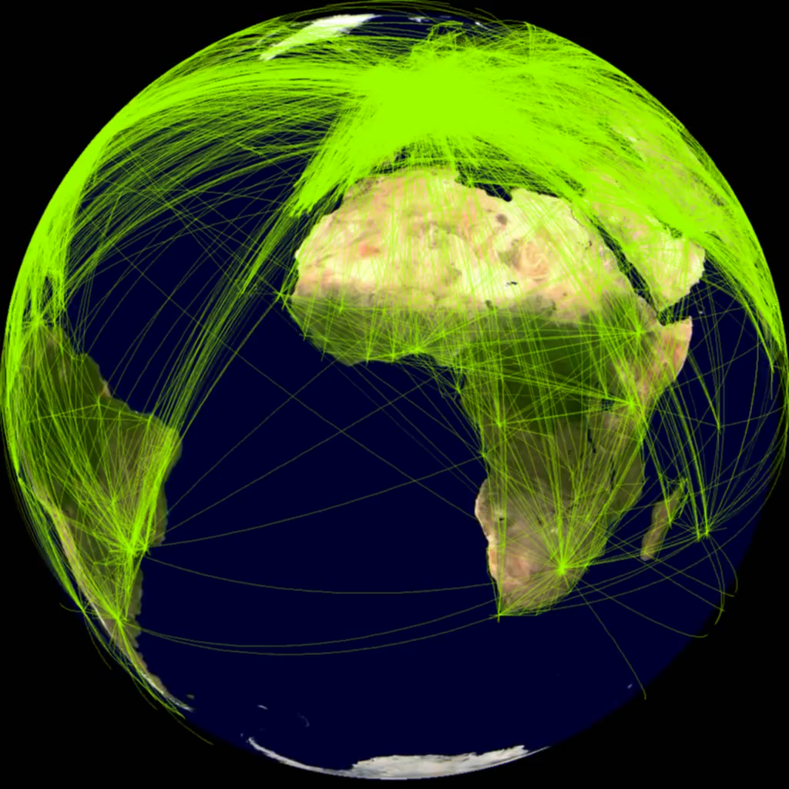
Modern Epidemics
It would spread much quicker.
Why?
Most likely due to air travel: these are all of the trade routes worldwide!

Slide 48
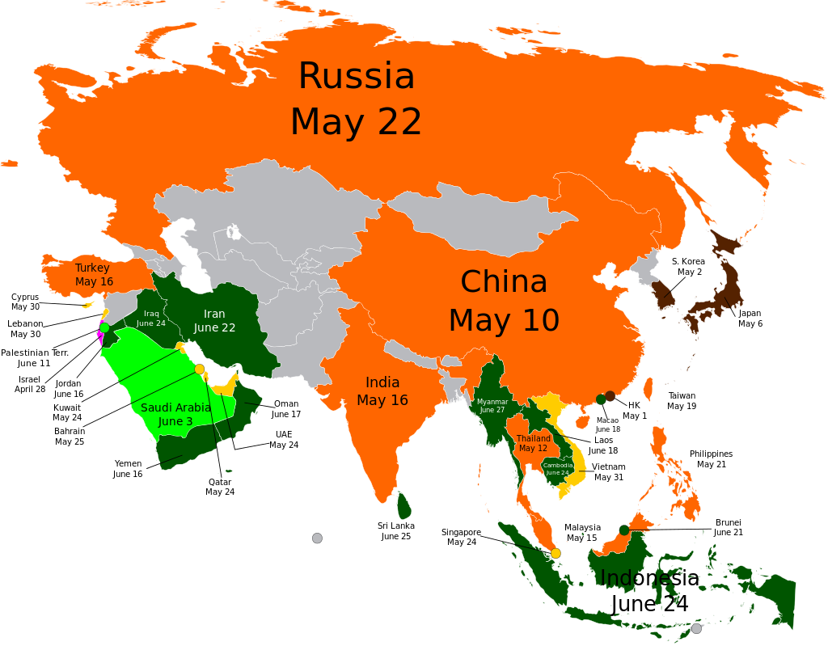
Swine Flu
In 2009, Swine Flu spread rapidly … much much quicker than the Black Death.

Slide 49
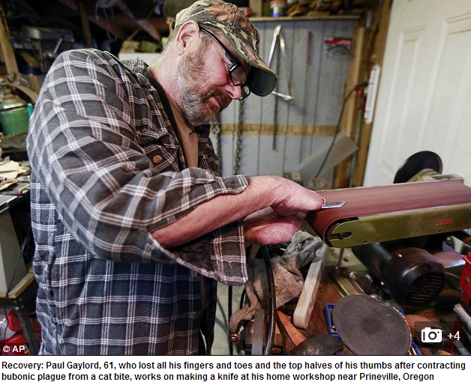
In fact …
…Yersinia Pestis is still around today!
The Black Death returned several times throughout history, most notably in the 17th century.
Outbreaks occur even today!
However, it can now be treated with antibiotics and the survival rate is much higher.
This guy caught the bacteria from a cat! His fingertips and toes needed to be amputated ☹
Read more here: http://www.theguardian.com/lifeandstyle/2014/jan/31/i-caught-plague-from-my-cat?CMP=twt_gu

Slide 50
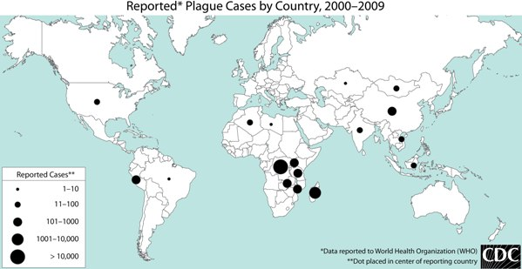
Plague Today …
What do you notice about the locations of cases of plague in modern times?
Notes:
Hopefully students will notice the relationship between cases of plague and developing regions. This is an opportunity to discuss the importance of medical aid to the developing world.

Slide 51
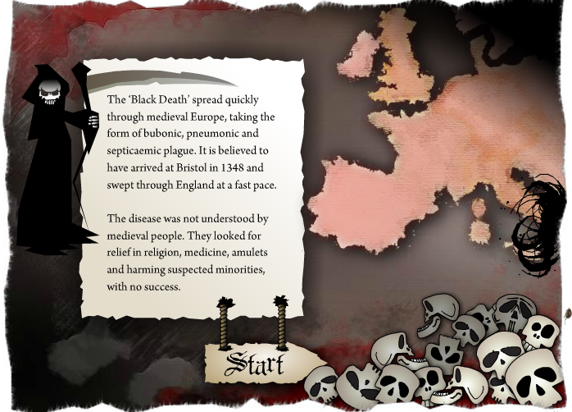
Extension Task:
Can you beat the Black Death?
http://www.sciencemuseum.org.uk/broughttolife/themes/diseases/black_death.aspx

Slide 52
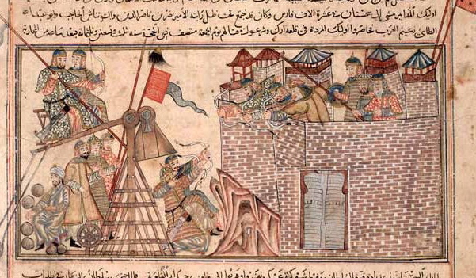
Extension Task
Biological Warfare:
Read up about the Siege of Caffa/Kaffa, a battle in which people who died of the plague were catapulted (!) over the city walls.
Did it really happen?
http://en.wikipedia.org/wiki/Feodossia (go to History section)
http://contagions.wordpress.com/2012/06/28/plague-at-the-siege-of-caffa-1346/
http://www.historyinanhour.com/2011/08/05/the-siege-of-kaffa-and-the-black-death/
http://wwwnc.cdc.gov/eid/article/8/9/01-0536_article

Slide 53
Australian Curriculum Links: Year 8 History
DEPTH STUDY 3: EXPANDING CONTACTS
The Black Death in Asia, Europe and Africa (14th century plague)
TRADE and the SPREAD of the BLACK DEATH
Living conditions and religious beliefs in the 14th century, including life expectancy, medical knowledge and beliefs about the power of God (ACDSEH015)
The role of expanding trade between Europe and Asia in the Black Death, including the origin and spread of the disease (ACDSEH069)
CAUSES and SYMPTOMS of the BLACK DEATH
The causes and symptoms of the Black Death and the responses of different groups in society to the spread of the disease, such as the flagellants and monasteries (ACDSEH070)
http://www.australiancurriculum.edu.au/humanities-and-social-sciences/history/

Slide 54
Images
All images from Open Clip Art.org and Wikimedia Commons.
Chamomile: By Fir0002 20D (Own work) [GFDL 1.2 (http://www.gnu.org/licenses/old-licenses/fdl-1.2.html)], via Wikimedia Commons
Brazil Open Sewer: By Valter Campanato/Agência Brasil [CC-BY-3.0-br (http://creativecommons.org/licenses/by/3.0/br/deed.en)], via Wikimedia Commons
Young Boy sits over an open sewer in the Kiberia slum Nigeria: By Trocaire from Ireland (Kibera17 Uploaded by victorgrigas) [CC-BY-2.0 (http://creativecommons.org/licenses/by/2.0)], via Wikimedia Commons
Water Pumps: By Oxfam East Africa [CC-BY-2.0 (http://creativecommons.org/licenses/by/2.0)], via Wikimedia Commons
Floor Rushes: Eric Jones [CC-BY-SA-2.0 (http://creativecommons.org/licenses/by-sa/2.0)], via Wikimedia Commons
Spices: "Spices in an Indian market" by judepics - http://www.flickr.com/photos/judepics/409841087/. Licensed under Creative Commons Attribution 2.0 via Wikimedia Commons - http://commons.wikimedia.org/wiki/File:Spices_in_an_Indian_market.jpg
Silk yarn: "Colours of India - Silk yarn waiting to be made into saris" by McKay Savage - originally posted to Flickr as India - Colours of India - Silk yarn waiting to be made into saris. Licensed under Creative Commons Attribution 2.0 via Wikimedia Commons - http://commons.wikimedia.org/wiki/File:Colours_of_India_-_Silk_yarn_waiting_to_be_made_into_saris.jpg
Spread of the Black Death Map 1: By Timemaps (Own work) [CC-BY-SA-3.0 (http://creativecommons.org/licenses/by-sa/3.0) or GFDL (http://www.gnu.org/copyleft/fdl.html)], via Wikimedia Commons
Roman Trade Routes: By Adhavoc (Own work) [CC-BY-SA-3.0 (http://creativecommons.org/licenses/by-sa/3.0)], via Wikimedia Commons http://commons.wikimedia.org/wiki/File%3AEurope_180ad_roman_trade_map.png
Spread of Swine Flu Map: "Spread of Swine Flu in Europe" by JZTess - Own work. Licensed under Creative Commons Attribution-Share Alike 3.0 via Wikimedia Commons - http://commons.wikimedia.org/wiki/File:Spread_of_Swine_Flu_in_Europe.svg#mediaviewer/File:Spread_of_Swine_Flu_in_Europe.svg

Slide 55
References
Bbc.co.uk, (2011). BBC - History - British History in depth: Black Death: The Effect of the Plague. [online] Available at: http://www.bbc.co.uk/history/british/middle_ages/plague_countryside_01.shtml [Accessed 20 Sep. 2014].
HISTORY.com, (2014). Black Death - Facts & Summary - HISTORY.com. [online] Available at: http://www.history.com/topics/black-death [Accessed 20 Sep. 2014].
Wade, N. (2010). Europe’s Plagues Came From China, Study Finds. [online] Nytimes.com. Available at: http://www.nytimes.com/2010/11/01/health/01plague.html?_r=0 [Accessed 20 Sep. 2014].
Water.org, (2014). Water Facts: Water. [online] Available at: http://water.org/water-crisis/water-facts/water/ [Accessed 30 Sep. 2014].
Wikipedia, (2014). Black Death. [online] Available at: http://en.wikipedia.org/wiki/Black_Death [Accessed 20 Sep. 2014].
Woodbury, Sarah, (2014). Life Expectancy in the Middle Ages | Sarah Woodbury. [online] Available at: http://www.sarahwoodbury.com/life-expectancy-in-the-middle-ages/ [Accessed 30 Sep. 2014].

Slide 56
Australian Curriculum Links: Year 8 History
‘What is the Black Death?’ covers:
Chronology, terms and concepts
Use historical terms and concepts (ACHHS149)
Analysis and use of sources
Identify the origin and purpose of primary and secondary sources(ACHHS152)
Depth Study 3: Expanding Contacts
The Black Death in Asia, Europe and Africa (14th century plague)
The effects of the Black Death on Asian, European and African populations, and conflicting theories about the impact of the plague (ACDSEH071)
http://www.australiancurriculum.edu.au/humanities-and-social-sciences/history/

Slide 57
License:
http://duffystirling.wordpress.com
This work is licensed under a Creative Commons Attribution-NonCommercial-ShareAlike 4.0 International License.

